Slide 1
LIBRARY MANAGEMENT SYSTEM
-SOWMIYA MADHAIYAN

Slide 2
Technology used:
Java 17
MySQL 8.0

Slide 3
Screens:
Login (Common for Student and Librarian)
Student Dashboard
Borrowed books
Librarian Dashboard
View Books
Issue Book
Return Book

Slide 4
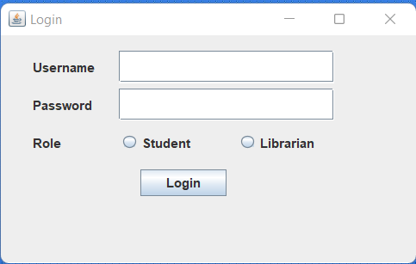
Login

Slide 5
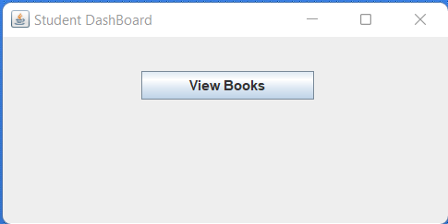
Student DashBoard

Slide 6
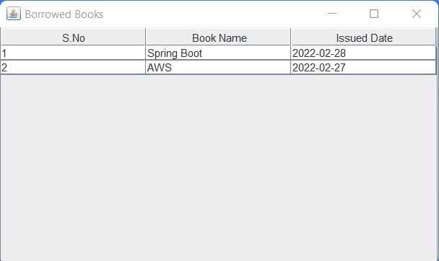
Borrowed Books

Slide 7
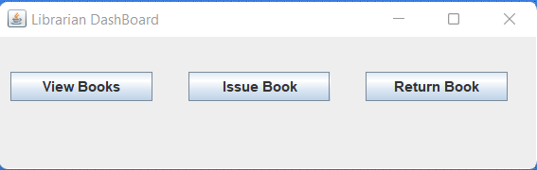
Librarian Dashboard

Slide 8
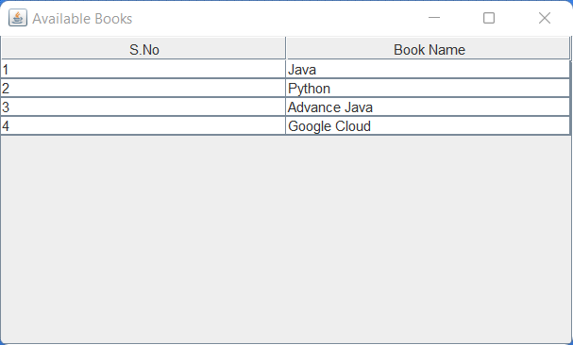
View Books

Slide 9
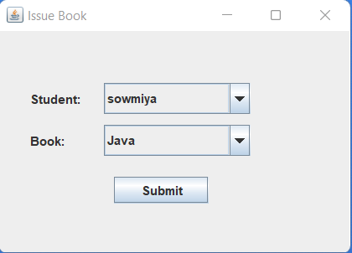
Issue Book

Slide 10
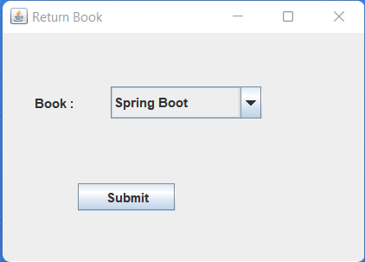
Return Book

Slide 11
